Slide 1
Data Visualization & Latex
Prof. Susanna Berkouwer
Pre-doc Training, August 2023

Slide 2
Communicating research
Prof. Susanna Berkouwer
Pre-doc Training, August 2023

Slide 3
Today
Graphing
Labelled: x-axis variable name, y-axis variable name, title
Scaled: y-axis should (almost*) always start at 0
Footnoted: How was the variable created?
Tables
Latex
Organizing your research output

Slide 4
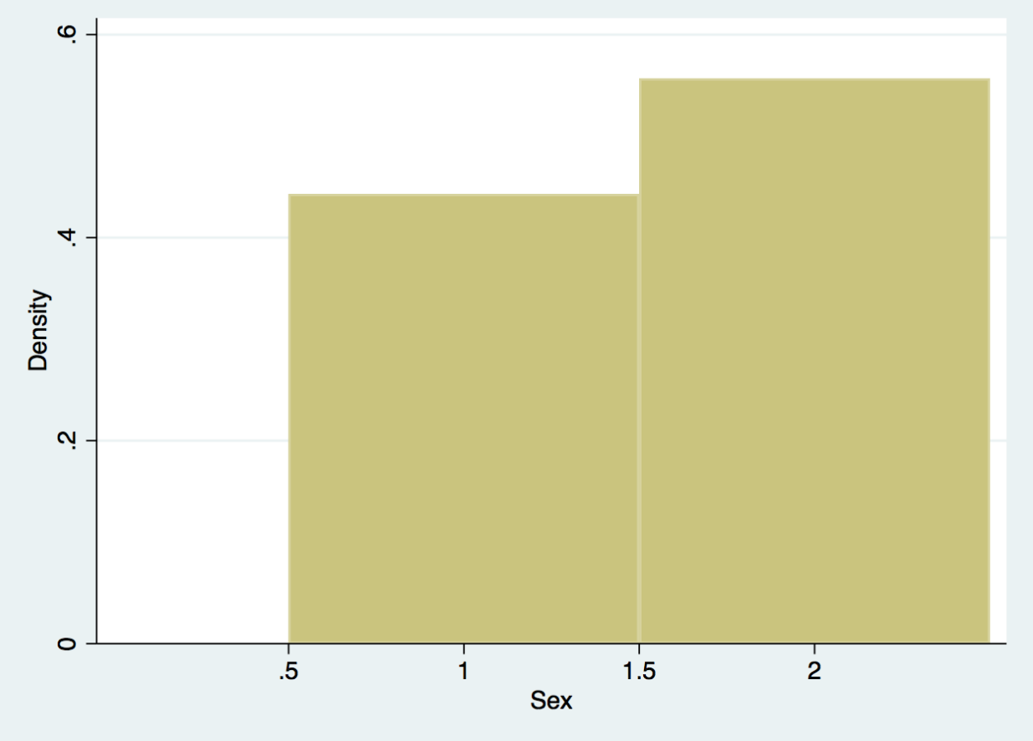
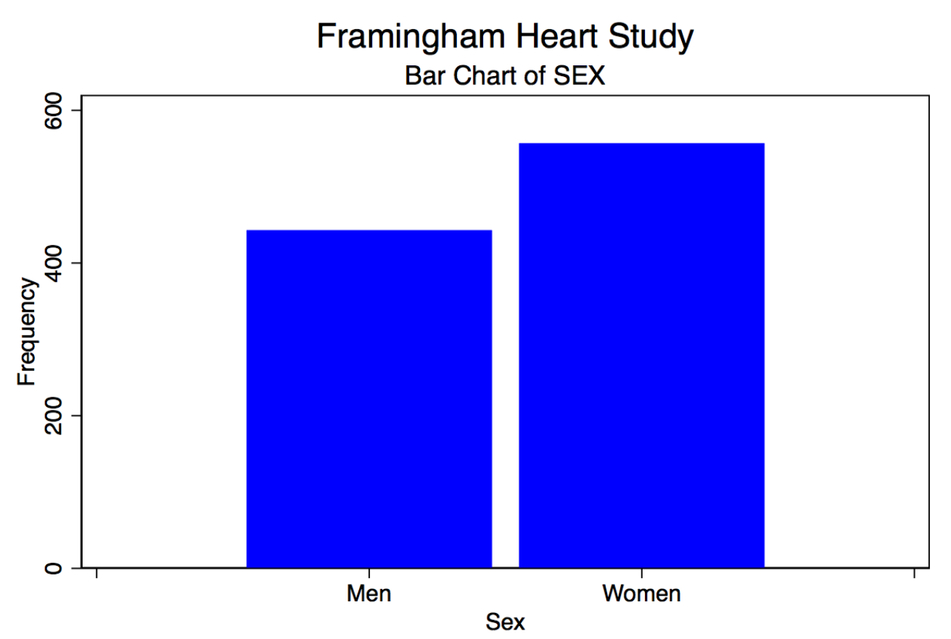
What should a histogram convey?
Data Visualization w Stata (UMASS guide)
What variable is on the x-axis? Is this continuous or discrete?
What is the sample size?
Where does the data come from?
What do the values mean?

Slide 5
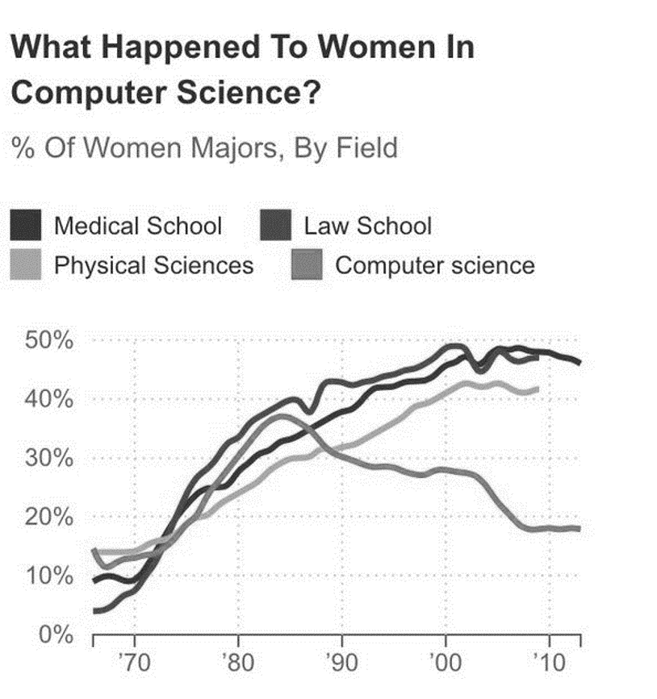
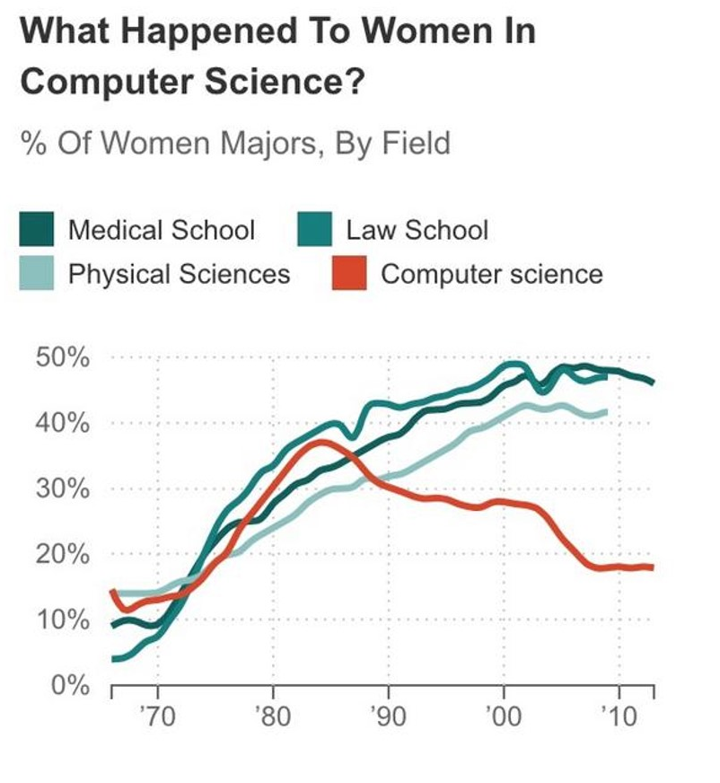
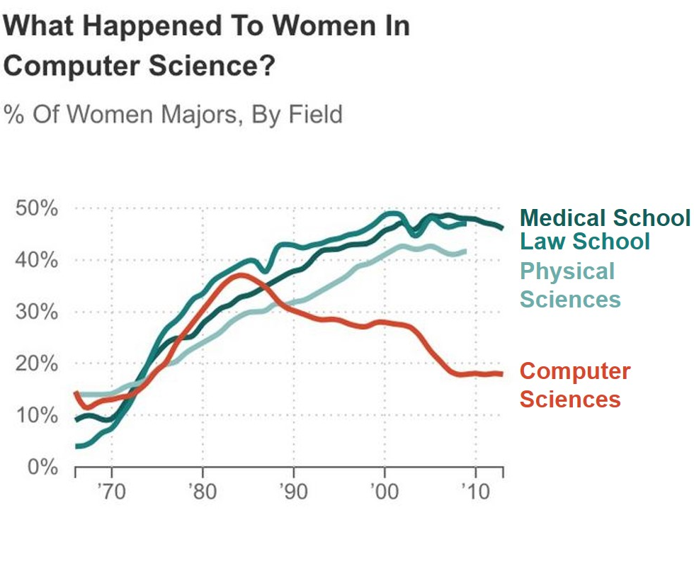
Label lines with quick legibility in mind
Ann K. Emery, depict data studio
(https://depictdatastudio.com/directly-labeling-line-graphs/)

Slide 6
Other important notes
Graphs should be legible for color-blind folks and with a grayscale printer
https://colorbrewer2.org/#type=qualitative&scheme=Dark2&n=3

Slide 7
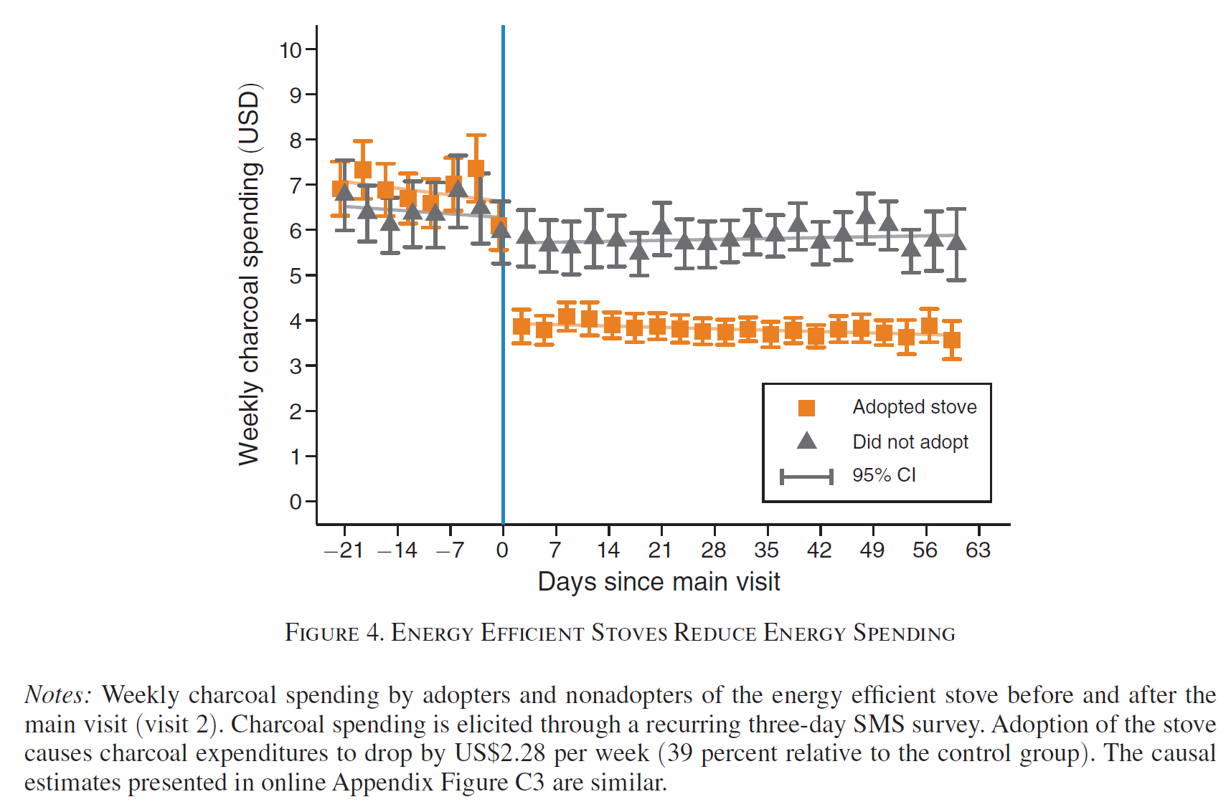
Coding in practice (Berkouwer & Dean; AER, 2022)
1 key take-away: “after main visit, spending dropped for adopters”
1 key point in time:
‘Main visit’
2 key groups:
Adopters
Non-adopters
3 key components:
Means (by day + adoption)
Confidence Intervals
Lines of best fit

Slide 8
Footnotes convey crucial information about variables

Slide 9
(Ask your PI / other pre-docs for code)
twoway (lfit mean CsinceV2 if jikokoa==0 & CsinceV2<=0, lcolor(gs10) connect(l)) ///
(lfit mean CsinceV2 if jikokoa==0 & CsinceV2> 1 , lcolor(gs10) connect(l)) ///
(lfit mean CsinceV2 if jikokoa==1 & CsinceV2<=0, lcolor(dkorange*0.5) connect(l)) ///
(lfit mean CsinceV2 if jikokoa==1 & CsinceV2> 1 , lcolor(dkorange*0.5) connect(l)) ///
(rcap ub lb Csince if jikokoa==1, mcolor(dkorange dkorange) lcolor(dkorange dkorange)) ///
(rcap ub lb Csince if jikokoa==0, mcolor(gs6 gs6) lcolor(gs6 gs6)) /// (scatter mean CsinceV2 if jikokoa==1, mcolor(dkorange) msymbol(S) lcolor(dkorange) lpattern(dash) connect(none)) /// (scatter mean CsinceV2 if jikokoa==0, mcolor(gs6) msymbol(T) lcolor(gs6) lpattern(shortdash) connect(none)), ///
`white' scale(1.5) ///
xline(0, lcolor(midblue)) ///
xsize(2.5) ysize(1.2) ///
yscale(range(0 `l')) ///
ylabel(#10, nogrid angle(0)) xlabel(-21(7)64, angle(0)) ///
ytitle("Weekly charcoal spending (`c')") ///
xtitle("Days since main visit") ///
legend(cols(1) pos(3) label(8 "Did not adopt") label(7 "Adopted stove") label(6 "95% CI") order(7 8 6) region(lcolor(white)) )

Slide 10
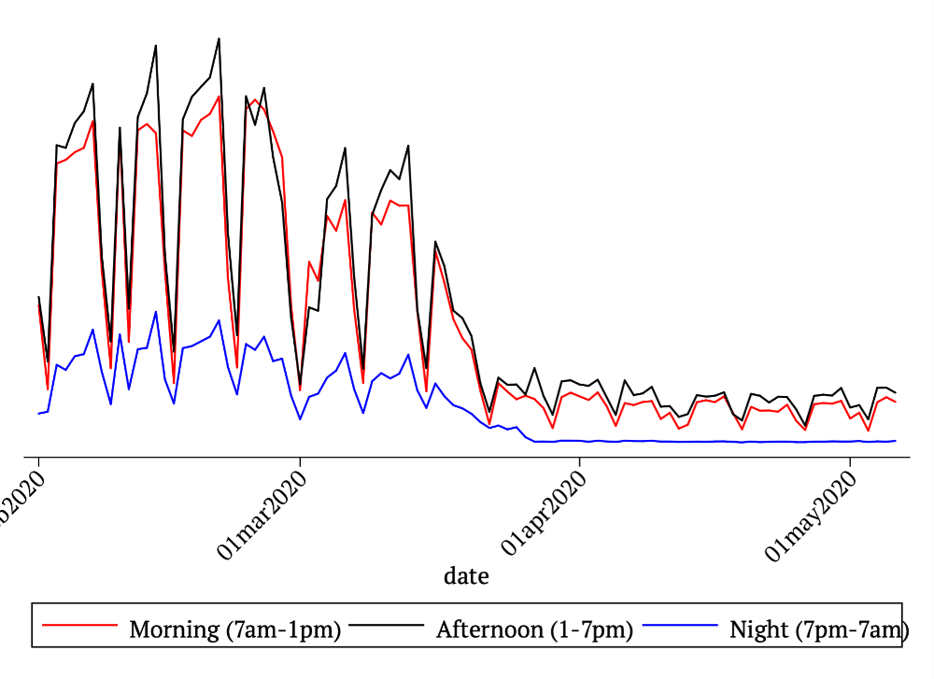
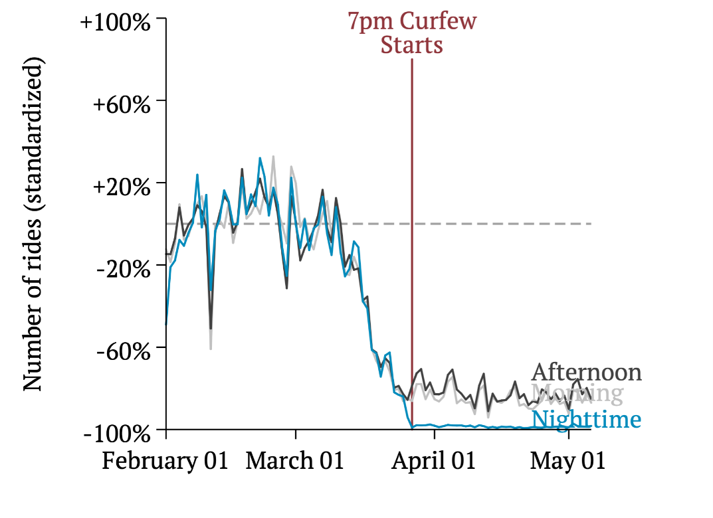
Label lines with quick legibility in mind
Berkouwer & Eggers (2020)

Slide 11
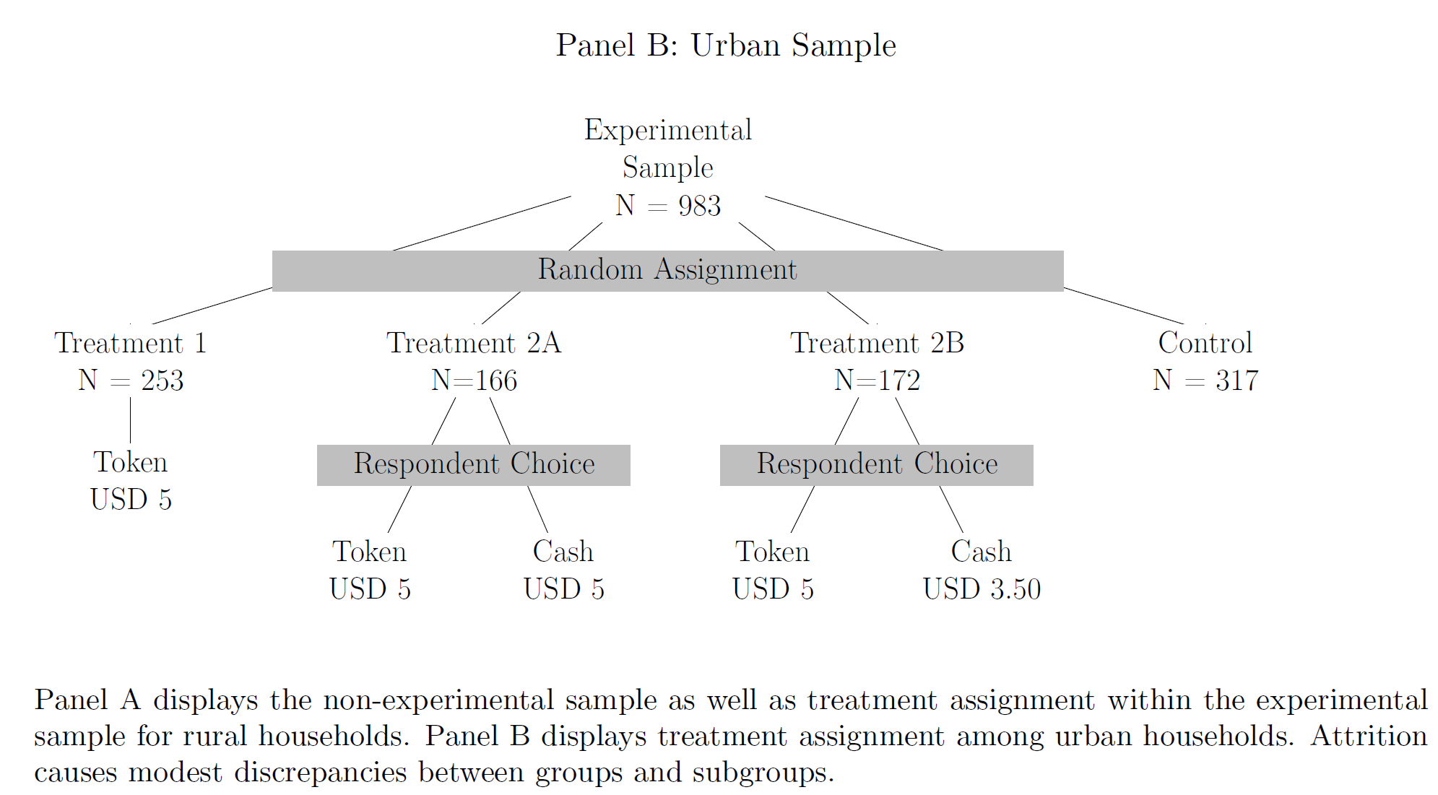
Tikz for graphs (Latex)
Berkouwer, Biscaye, Hsu, Kim, Lee, Miguel, Wolfram (2021)

Slide 12
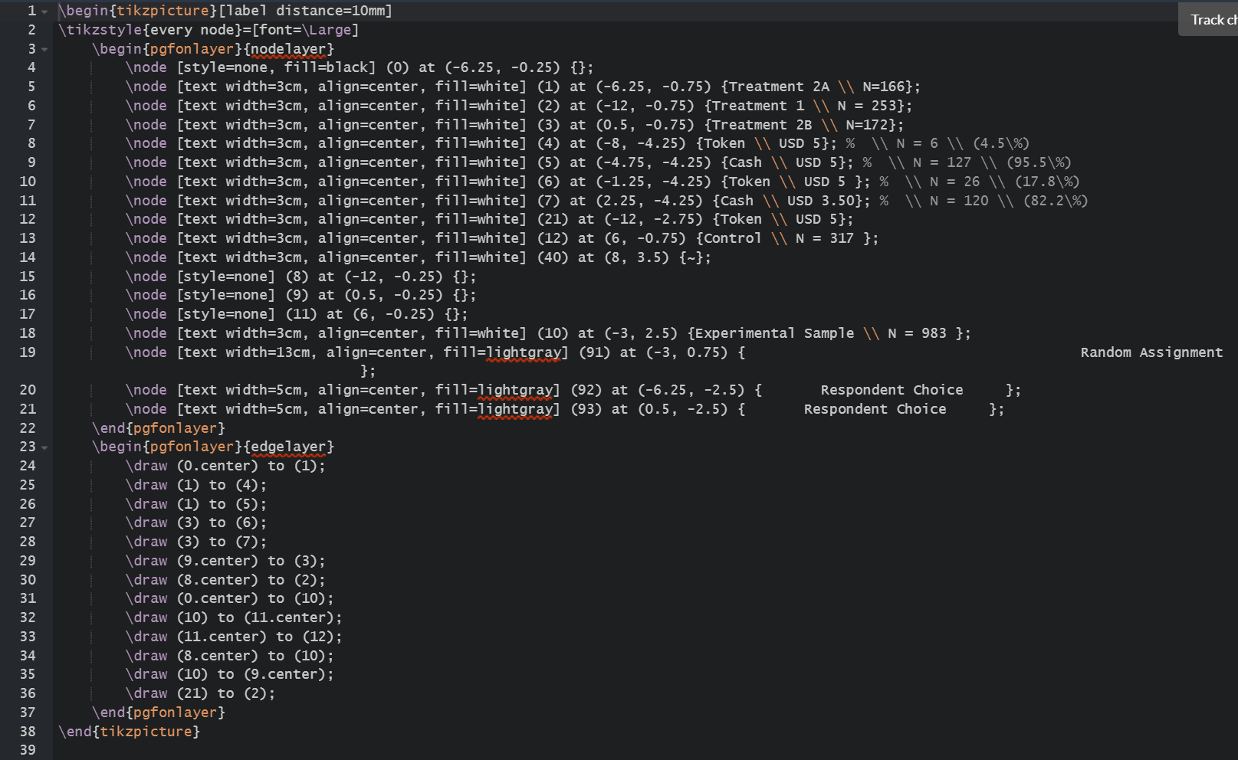
Tikz for graphs (Latex)
Define labelled nodes
Some invisible nodes too:
Add decision rectangles
Connect nodes with lines

Slide 13
Today
Graphing
Tables
Latex
Organizing your research output

Slide 14
What should a table convey?
Berkouwer & Dean (AER, 2022)

Slide 15
What should a table convey?
Data source
How variables were constructed
Sample size
Regression specification
e.g. OLS, IV
Outcome variable
Independent variables
Other controls (fixed effects, controls)
Significance
Stars (some journals don’t allow this anymore!)
Standard errors

Slide 16
Today
Graphing
Tables
Latex
Organizing your research output

Slide 17
Installing LaTeX
Install a TeX distribution (TeX Live, MiKTeX, or MacTeX)
Install an editor (Lyx, TeXmaker, or other)
Export to PDF

Slide 18
Installing LaTeX
Install a TeX distribution (TeX Live, MiKTeX, or MacTeX)
Install an editor (Lyx, TeXmaker, or other)
Export to PDF
Just use Overleaf.com

Slide 19
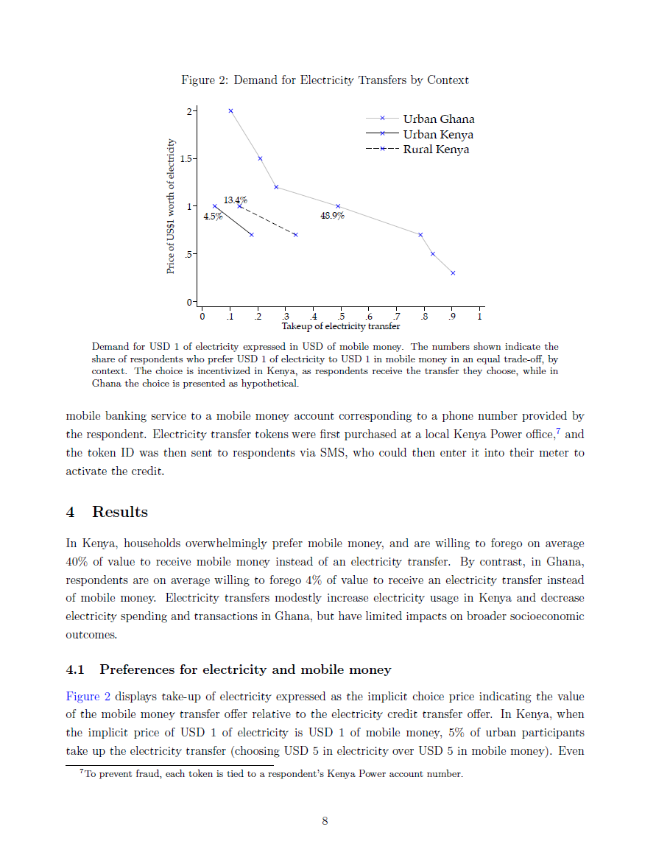
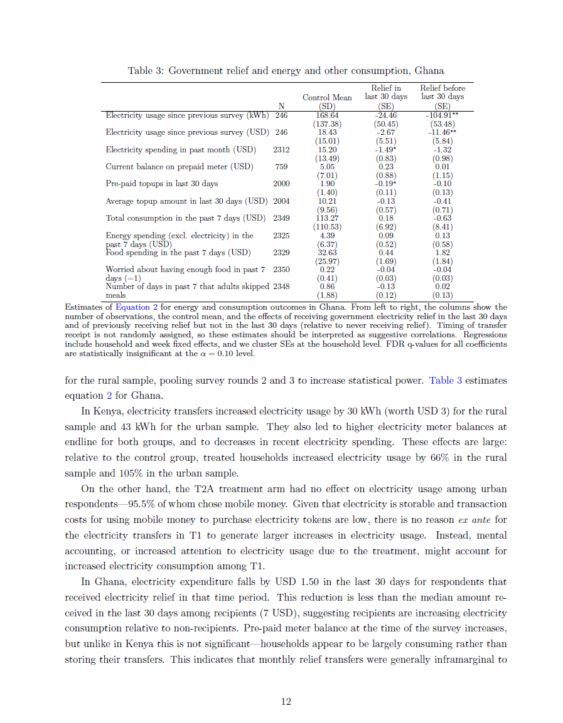
Calling the graphs & tables you made

Slide 20
Calling graphs you made (ask your PI / other pre-docs for code)
\begin{figure}[h]
\caption{Energy efficient stoves reduce energy spending}
\begin{flushright}
\begin{minipage}{0.9\textwidth}
\label{fig:diffindiff}
\includegraphics[width=1\textwidth]{"Images/DiffInDiffCharcoal_USD_PAPER".pdf}
\end{minipage}
\end{flushright}
\justify \footnotesize Weekly charcoal spending by adopters and non-adopters of the energy efficient stove before and after the main visit (visit 2). Charcoal spending is elicited through a recurring 3-day SMS survey. Adoption of the stove causes charcoal expenditures to drop by USD 2.27 per week (40 percent relative to the control group). The causal estimates presented in \autoref{fig:diffindiffIV} are similar.
\end{figure}

Slide 21
Calling tables you made (ask your PI / other pre-docs for code)
Added in Latex
What you made in Stata/R
Added in Latex
Berkouwer & Dean (AER, 2022)

Slide 22
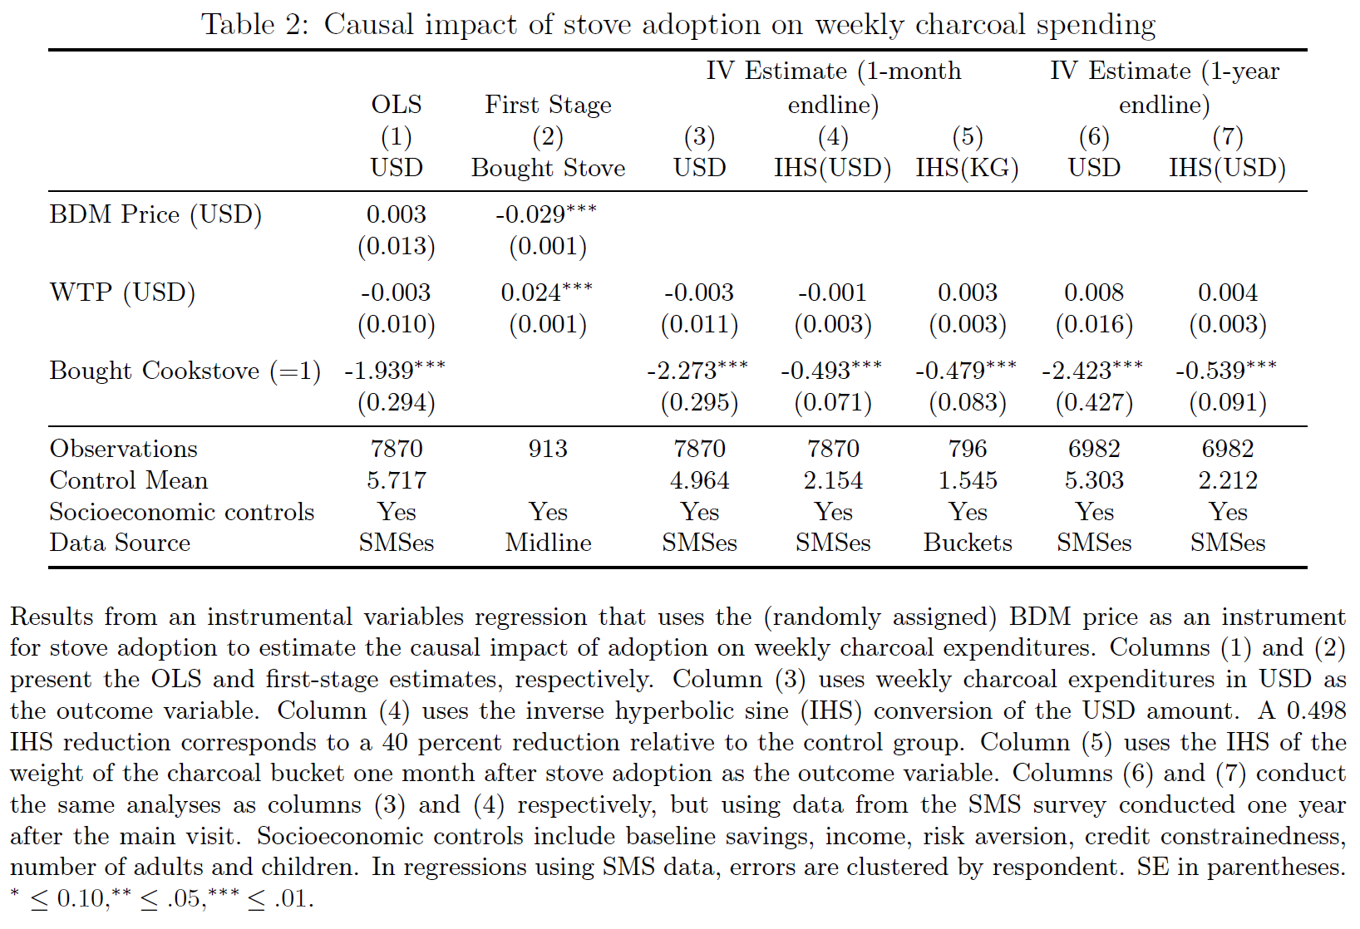
Calling tables you made (ask your PI / other pre-docs for code)
\begin{table}[h]
\begin{center}
\caption{Causal impact of stove adoption on weekly charcoal spending} \label{tab:ivresults}
\addtolength{\tabcolsep}{-5pt}
\begin{tabular}{@{\extracolsep{6pt}}lccccccccc}
\toprule
\input{Tables/IVcharcoal_PAPER.tex}
\bottomrule
\end{tabular} \\
\end{center}
\footnotesize Results from an instrumental variables regression that uses the (randomly assigned) BDM price as an instrument for stove adoption to estimate the causal impact of adoption on weekly charcoal expenditures. Columns (1) and (2) present the OLS and first-stage estimates, respectively. Column (3) uses weekly charcoal expenditures in USD as the outcome variable. Column (4) uses the inverse hyperbolic sine (IHS) conversion of the USD amount. A 0.498 IHS reduction corresponds to a 40 percent reduction relative to the control group. Column (5) uses the IHS of the weight of the charcoal bucket one month after stove adoption as the outcome variable. Columns (6) and (7) conduct the same analyses as columns (3) and (4) respectively, but using data from the SMS survey conducted one year after the main visit. Socioeconomic controls include baseline savings, income, risk aversion, credit constrainedness, number of adults and children. In regressions using SMS data, errors are clustered by respondent. SE in parentheses. ${^*}\leq0.10, ^{**}\leq.05, ^{***}\leq.01$.
\end{table}

Slide 23
Today
Graphing
Tables
Latex
Organizing your research output

Slide 24
Organizing your research output
Challenge:
Many datasets with many variables and many ways of cleaning them
Many draft versions that may not make it into the paper
Many regressions
Many analyses
Many revisions of old analyses
Solution:
Label and describe everything
Date everything
e.g. a continuously updated PDF with versions of results

Slide 25
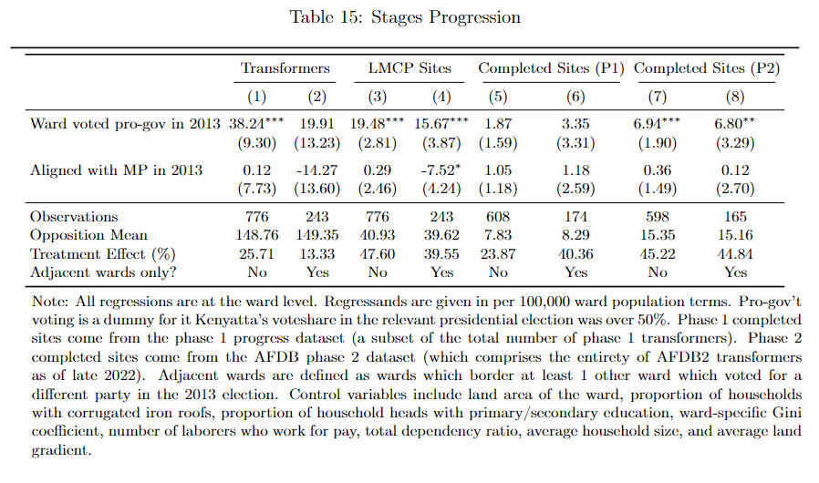
The research process is revise, revise, revise
Is each regression OLS/IV/…?
What is the outcome variable?
Which sample did you use?
How did you construct variables?
What control variables did you include?
What fixed effects and clustering are included?

Slide 26
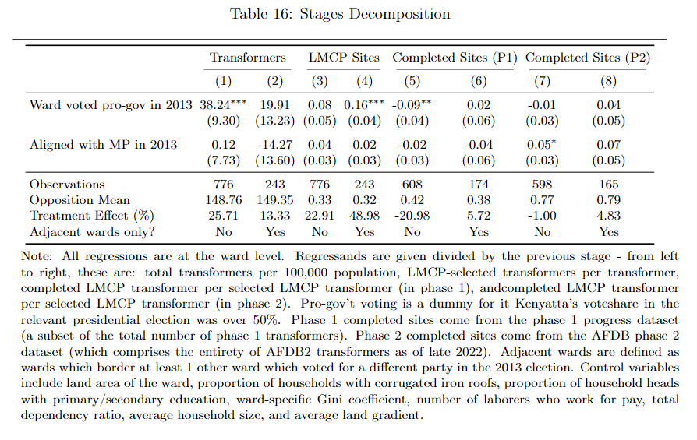
The research process is revise, revise, revise
Is each regression OLS/IV/…?
What is the outcome variable?
Which sample did you use?
How did you construct variables?
What control variables did you include?
What fixed effects and clustering are included?

Slide 27
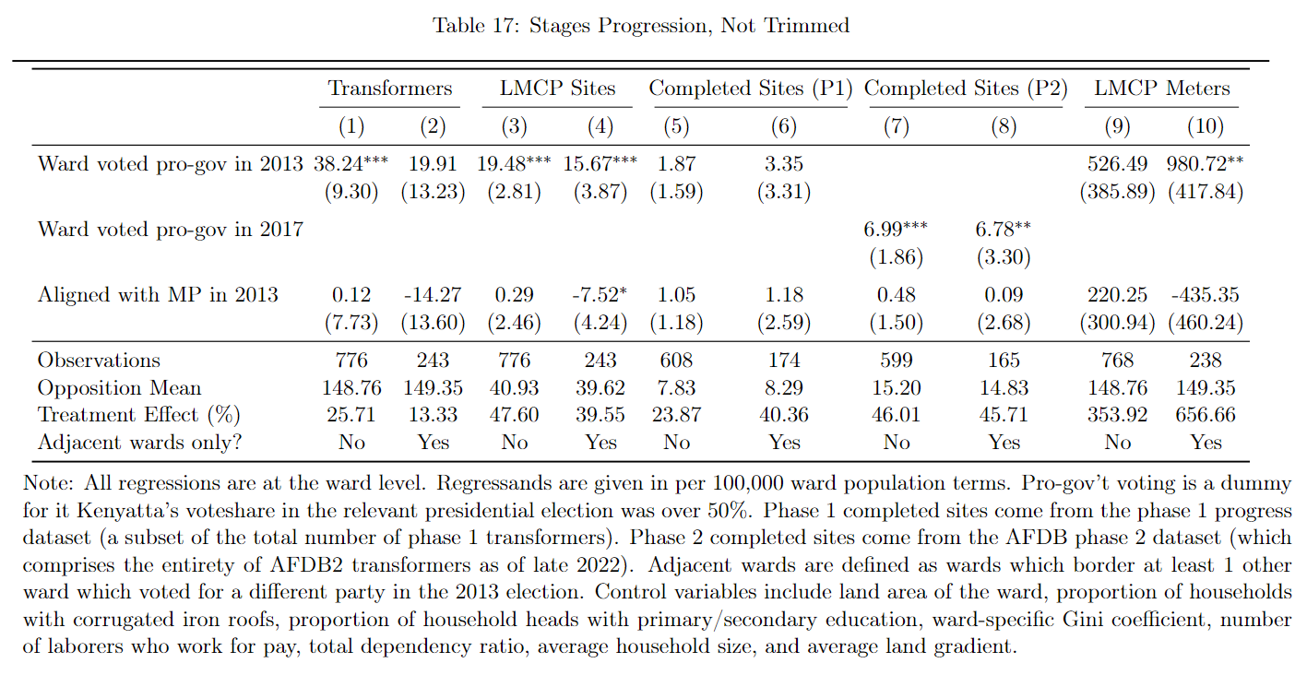
The research process is revise, revise, revise
Is each regression OLS/IV/…?
What is the outcome variable?
Which sample did you use?
How did you construct variables?
What control variables did you include?
What fixed effects and clustering are included?

Slide 28
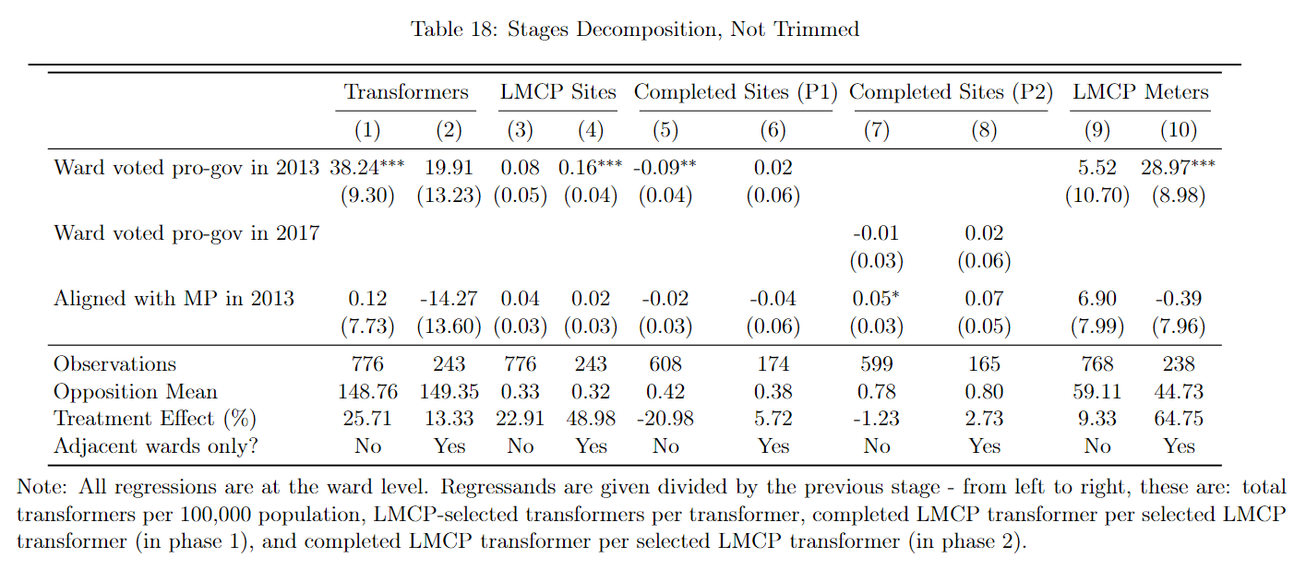
The research process is revise, revise, revise
Is each regression OLS/IV/…?
What is the outcome variable?
Which sample did you use?
How did you construct variables?
What control variables did you include?
What fixed effects and clustering are included?

Slide 29
A replication dataset has 5 key folders
DATA
RAW
.xlsx, .csv, .txt, .doc, .pdf, etc. (direct download from website/research partner)
MEDIUM
.dta, .r (imported, merged, cleaned of typos)
CLEAN
.dta, .r, (variables used in analysis)
DO
Master file with paths and settings (.do, .R, etc.)
Cleaning file(s) (.do, .R, etc.)
Analysis file(s) (.do, .R, etc.)
SURVEYING INSTRUMENTS
Baseline survey (word/excel)
Endline survey (word/excel)
PACKAGES
.ado
RESULTS
GRAPHS
.eps, .pdf, .png
TABLES
.tex
MAPS
.eps, .pdf, .png
ReadMe.docx (sources of raw data files, explanation of files)
RunAll.do, RunAll.R (replicates entire project)

Slide 30



